Slide 1
Documentum Compliance Manager
September 2011
Kyeseong Lee

Slide 2
What is DCM
Product helps customers meet compliance requirements.
DCM Web application is provided.
Document is tightly controlled when it moves along the lifecycle of its Document Class.
Also additional features are provided, such as PDF Stamping services or PCS.

Slide 3
Features of DCM, on top of Webtop features
1. automatically attach a lifecycle to a controlled document upon creation or import
2. enforce certain lifecycle states
3. restrict manual transition from one state to another
4. prevent the document from being deleted in certain states
5. schedule automatic review of any and each approved, in use (effective) document
6. make approved documents in use (effective) upon a certain date
7. make a version of an approved document in use or effective, for a temporary period of time, suspend the currently effective document and then reinstate the original to in use, effective after the temporary period expires
8. move a document from in use, effective to retired state upon a certain date

Slide 4
Features of DCM, continued
9. move a document from in use, effective to retired state when a new version becomes in use, effective
10. move an entire family (version tree) of documents from the in use to the records management (Obsolete) state
11. control versioning such as enforcing new in use (effective) versions to be whole numbers
12. delete all pre-effective versions of a document upon a version of the document becoming in use, effective
13. force documents to revert to the base state upon checkin at any stage in the lifecycle
14. manage renditions such as force the creation of a new rendition of a document upon check-in if it already had a rendition
15. overlay static or dynamic information, in real time, on content during viewing, printing, and export, with different overlays during each activity

Slide 5
Features of DCM, continued
16. enforce different View and Print overlays
17. limit view access to the PDF renditions to users in general, only allowing access to the original to certain roles
18. limit the access to approved, in use (effective) documents to the consumer role, this is without ACL’s
19. enforce printing and file controls i.e. control where printing is done and by whom
20. control whether people can export files
21. limit search results to only approved, in use (effective) documents
22. manage a set of templates for each document type
23. relate documents and take them through their lifecycle together as a group. (not a VDM but very similar in functionality)
24. support a change process through change request and change notice functionality

Slide 6
Features of DCM, continued
25. enforce unique naming of documents
26. auto number documents
27. configure enhanced, audited notifications including TBRs
28. support enhanced auditing in general
29. extended the lifecycle processing e.g. the ability to associate a set of workflows with a lifecycle state
30. limit authoring of controlled content to a specific group, and manage a set of authors for each document class
31. manage and control a set of signatories both mandatory and optional for each document class
32. assist companies to comply with 21 Code of Federal Regulations part 11 by capturing, auditing, and manifesting e-signatures

Slide 7
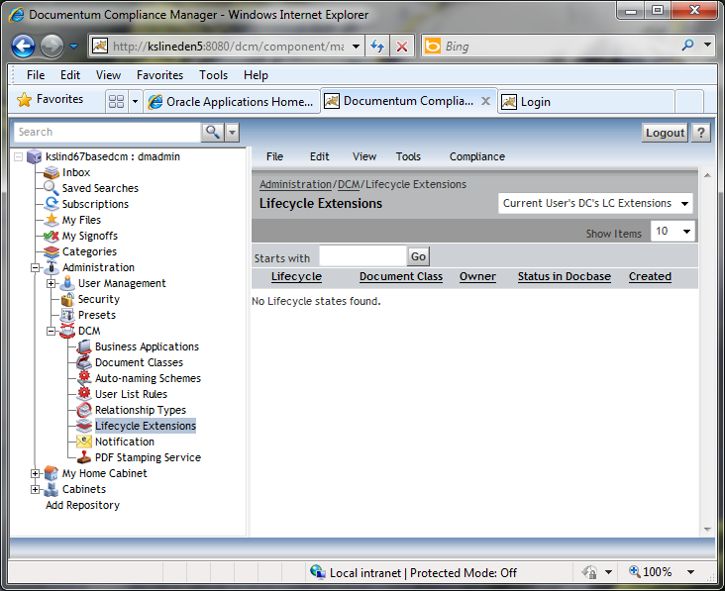
DCM Application
Notice DCM tab under Administration

Slide 8
Core concepts of DCM
Controlled Document
DCM manages controlled documents to achieve compliance purpose
Document Class and Business Application
Controlled document is created or converted to as an object of Document Class.
Document Class and Business Application objects are created by DCM Administrator group.
Also custom Document Class can be also defined.
Document Class works as hub to package other concepts.
Lifecycle Extension
Each Document class is given its own lifecycle.
Lifecycle extension is applied to controlled documents of that Document Class.
3 Lifecycles are available when DCM is installed (Default Application, Change Request and Change Notice)
Workflow
Used to promote controlled document along its lifecycle.
5 DCM Workflows are provided by default.

Slide 9
Additional concepts of DCM
Other features in DCM tab.

Slide 10
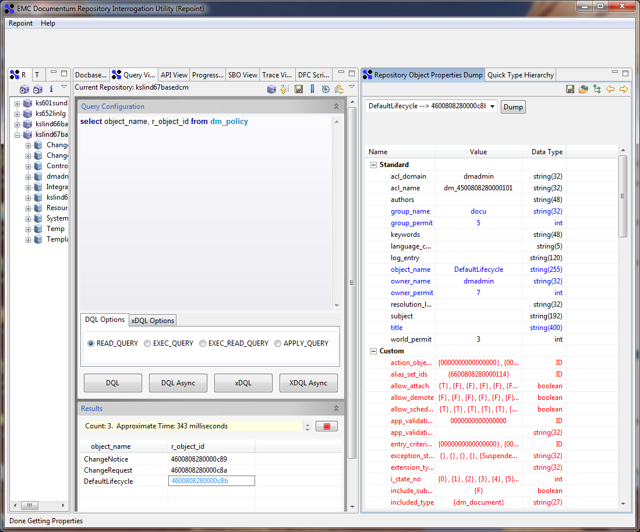
Lifecycle of DCM

Slide 11
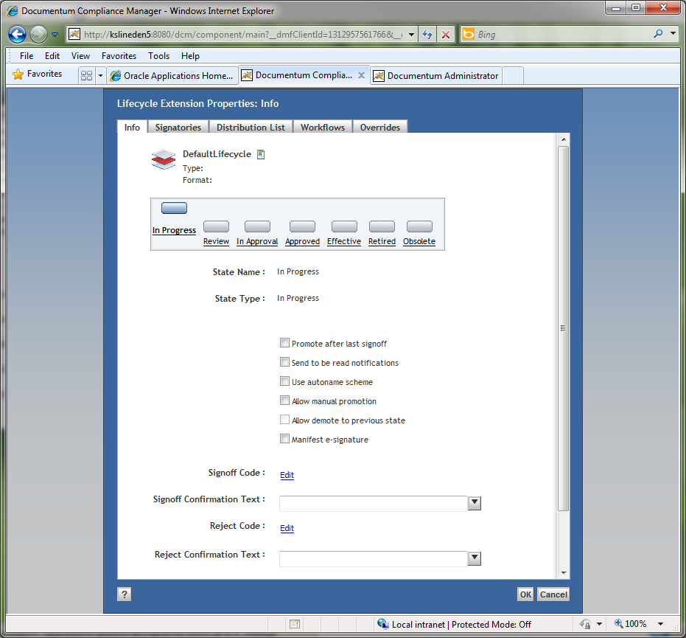
Lifecycle of DCM

Slide 12
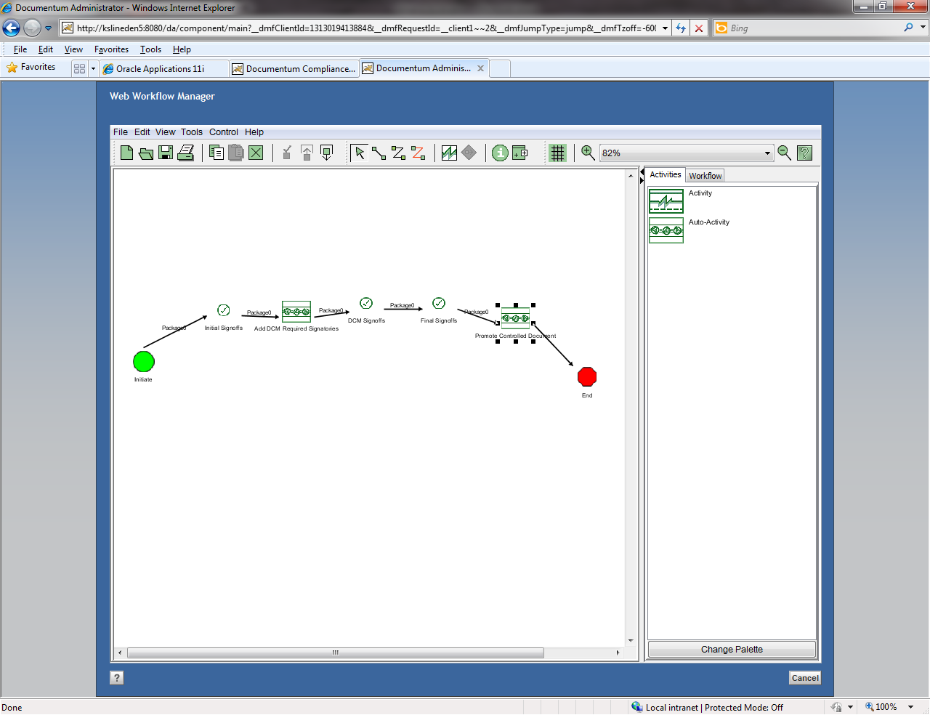
Lifecycle of DCM

Slide 13
Additional concepts of DCM
Other features in DCM tab.

Slide 14
Installation of DCM
Prepare Global Repository.
Install Content Server and Create Docbase for DCM.
Install J2EE Application Server and deploy DCM Application.
Install DARs for DCM to DCM Docbase and GR.
Install additional products
PAS (PDF Annotation Service)
-> PAS patch will integrate PDF Annotation Services with the PDF Stamping Services
PCS (Print Control Service)
->This is separate product, and available only for Windows.
Install Queue Manager

Slide 15
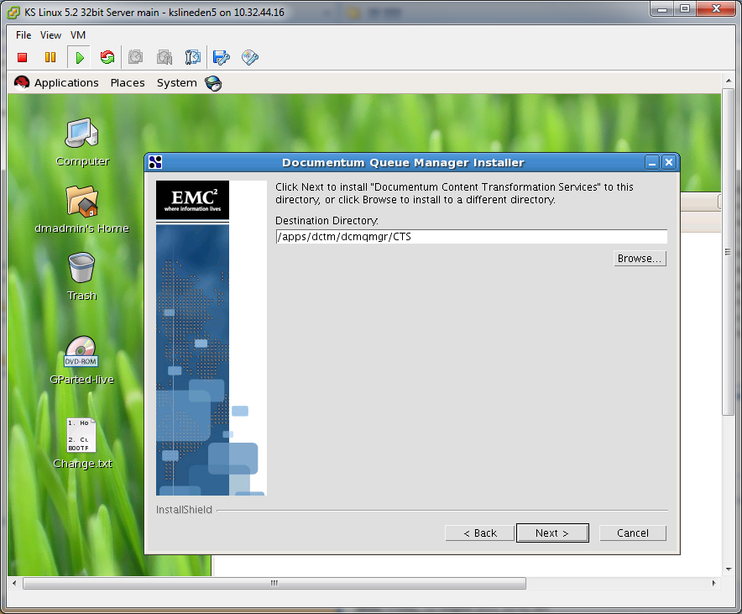
Queue Manager installation

Slide 16

Demonstration

Slide 17
Q&A

